Slide 1
Introduction to ARMA International
8TH TRIENNIAL CONFERENCE OF DLM FORUM ON INFORMATION GOVERNANCE
BRIGHTON, 13 SEPTEMBER 2017

Slide 2
Tim Callister – Regional Director, ARMA European Region
Tony Allen – President, ARMA UK Chapter

Slide 3
ARMA International is a not-for-profit professional association and an authority on governing information as a strategic asset.
The association was established in 1955. Its members include records and information managers, information governance professionals, archivists, corporate librarians, imaging specialists, legal professionals, IT managers, consultants, and educators, all of whom work in a wide variety of industries, including government, legal, healthcare, financial services, and petroleum in the United States, Canada, and more than 30 other countries around the globe.

Slide 4
Core Purpose Statement To promote principles and practices that 1) result in organizations understanding that their success relies on the effective management and governance of information and 2) create career and professional development opportunities in RIM and information. Mission Statement To provide information professionals the resources, tools, and training they need to effectively manage records and information within an established information governance framework.

Slide 5
Generally Accepted Recordkeeping Principles®
The Generally Accepted Recordkeeping Principles® (Principles) constitute a generally accepted global standard that identifies the critical hallmarks and a high-level framework of good practices for information governance. Published by ARMA International in 2009 and updated in 2017, the Principles are grounded in practical experience and based on extensive consideration and analysis of legal doctrine and information theory. They are meant to provide organizations with a standard of conduct for governing information and guidelines by which to judge that conduct.

Slide 6
Generally Accepted Recordkeeping Principles®
Principle of Accountability Principle of Transparency
Principle of Integrity Principle of Protection
Principle of Compliance Principle of Availability
Principle of Retention Principle of Disposition

Slide 7
Information Governance and The Principles
The Generally Accepted Recordkeeping Principles® (Principles) constitute a generally accepted global standard that identifies the critical hallmarks and a high-level framework of good practices for information governance, which ARMA International defines as:
“A strategic, cross-disciplinary framework composed of standards, processes, roles, and metrics that hold organizations and individuals accountable for the proper handling of information assets. The framework helps organizations achieve business objectives, facilitates compliance with external requirements, and minimizes risk posed by substandard information handling practices. Note: Records and information management (RIM) is an essential building block of an information governance program.”

Slide 8
Who We Are
The Foundation is the leading foundation that enhances the practical and scholarly knowledge of information management by funding and promote research, scholarship, and educational opportunities for information management professionals.
What We Do
Our mission is to support research that addresses critical issues in information management; provide funding opportunities to enhance knowledge, skills and abilities of practitioners in the field; and foster educational initiatives that develop information management skills and programs.

Slide 9
The ARMA International Educational Foundation (AIEF) is excited to announce the availability of a variety of funding opportunities for current and aspiring records and information management professionals.
- Graduate education scholarships - $1,000
- Access Leadership scholarships - $6,000 & $2,000
- RIM certificate/certification reimbursement awards - $500
These awards include scholarship and reimbursement awards to cover costs associated with:
- Earning a bachelor's degree
- Earning a graduate-level degree
- Earning a CRM (Certification of Records Management), IGP (Information Governance Professional Certification), or other RIM related certifications

Slide 10
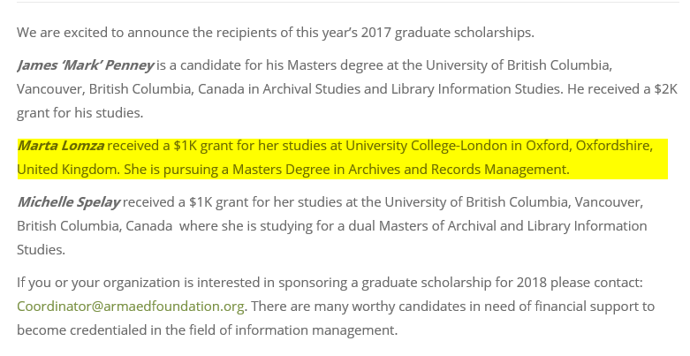
AIEF in the UK

Slide 11
What is an IGP?
An Information Governance Professional (IGP) is a person who has earned the only certification that demonstrates he or she has the strategic perspective and the requisite knowledge to help an organization leverage information for maximum value while reducing the costs and mitigating the risks associated with using and governing this important asset.
Why invest to become an IGP?
It helps improve the speed of business for your organization
It will help you use information more effectively
It will help you become more successful, professionally
Mission of the Information Governance Professional (IGP) Certification Program:
Provide an information governance credential within an ethical and professional framework to support individuals to deliver organizational value and reduce risk.

Slide 12
ARMA International provides opportunities for tremendous face-to-face conferences and seminars for information governance professionals. For nearly 60 years, ARMA International's Annual Conference & Expo has provided information management professionals with cutting-edge education and training on topics ranging from electronic document management to business continuity planning and beyond.

Slide 13
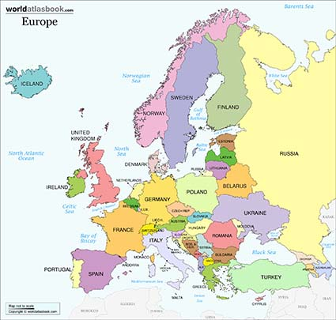
ARMA European Region
Our Membership is spread across the whole of Europe with key hubs in the UK & Switzerland.
We are actively seeking to help Members establish new chapters and communities where numbers can support this.

Slide 14
UK Chapter
Established 2012
20+ core Chapter members – in addition to being ARMA members in Europe.
Past events have included:
Data Privacy, ISO 15489 roundtable, Defensible Disposition, Bank of England Past and Present, Preserving Electronic Records
Next meeting November 15th – “GDPR – A Practical Approach”

Slide 15
Membership
Professional Member ($175 annually)
Associate Member ($95 annually)
This is our first step into membership, recommended for students and retired professionals. Associate Members can join an ARMA International chapter and will also have access to our award-winning Information Management e-magazine. It’s a great way for those new to information management to get up to speed and see what ARMA International can do for them.
Friend of ARMA ($0)
In the past, we’ve considered nonmembers to be only customers. But they’re so much more than that. They are our friends and our colleagues, and we’re happy to provide them with the resources and education they need.

Slide 16
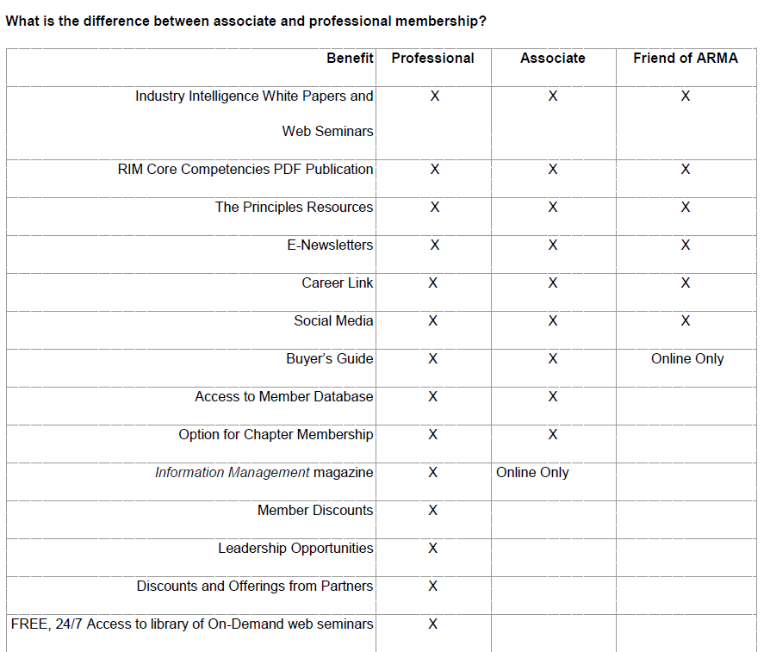

Slide 17
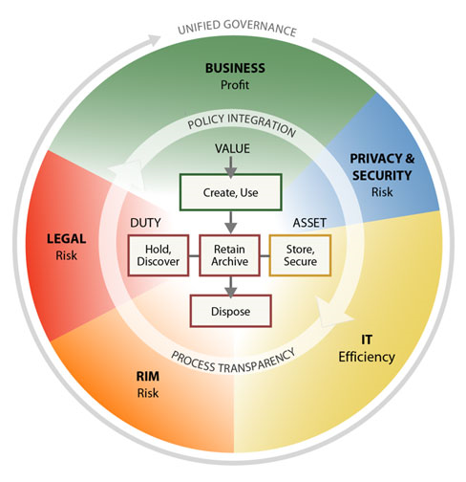
Information Governance Challenges

