Slide 1
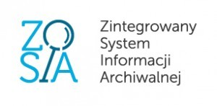
The Integrated Archival Information System “ZoSIA” and Its Implications for Archival Descriptive and Reference Practices in the Polish State Archives
Bartosz Nowożycki
The Head Office of State Archives, Department of Archival Sciences

Slide 2
SEZAM database (v.6.2), fonds-level description

Slide 3
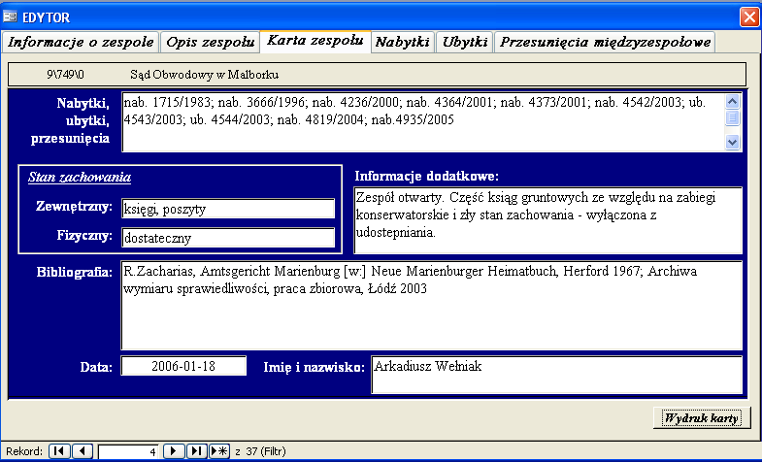
SEZAM database (v.6.2), description of an archvial fond

Slide 4
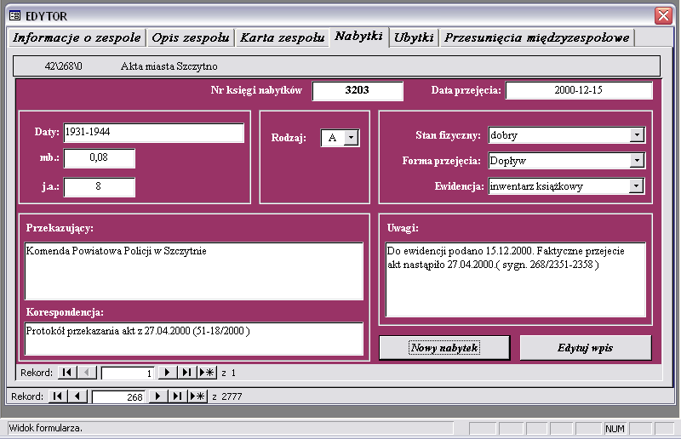
SEZAM database (v.6.2), accession and deaccession registers

Slide 5
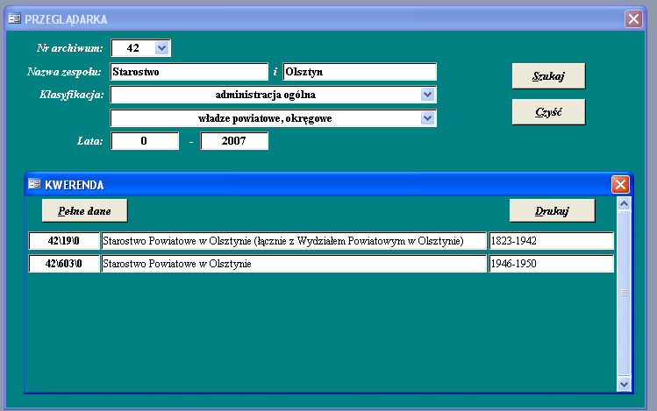
SEZAM database (v.6.2), search engine and reports

Slide 6
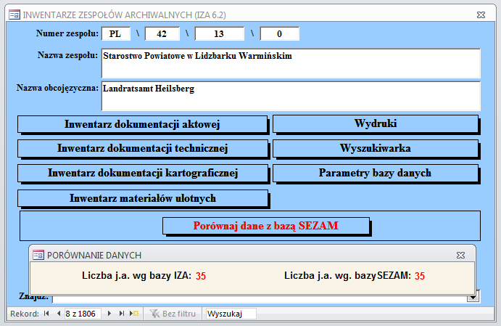
IZA database (v.7.0), archival fond description

Slide 7
IZA database (v.7.0), item-level description

Slide 8
IZA database (v.7.0), search engine and reports

Slide 9
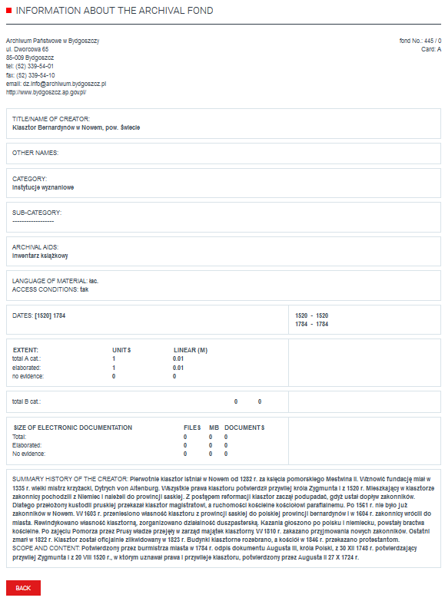
SEZAM and IZA online search

Slide 10
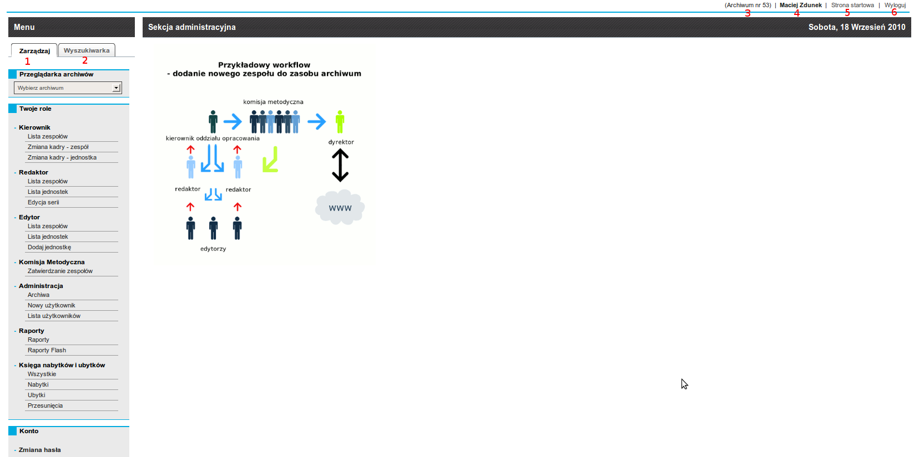
The Integrated Archival Information System “ZoSIA”, main screen

Slide 11
The Integrated Archival Information System “ZoSIA”, list of archival fonds and collections

Slide 12
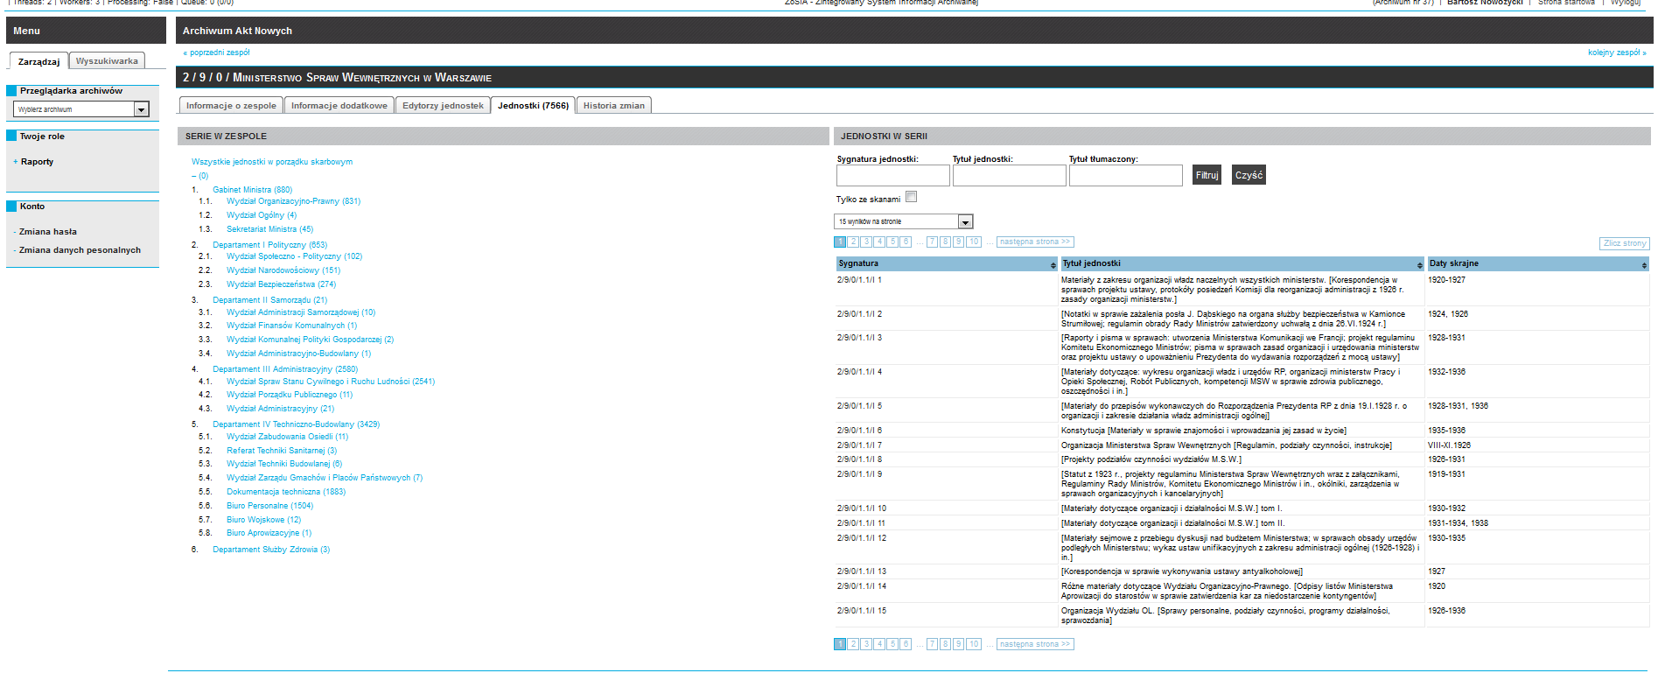
The Integrated Archival Information System “ZoSIA”, list of series and record units in an archival fond or collecton

Slide 13
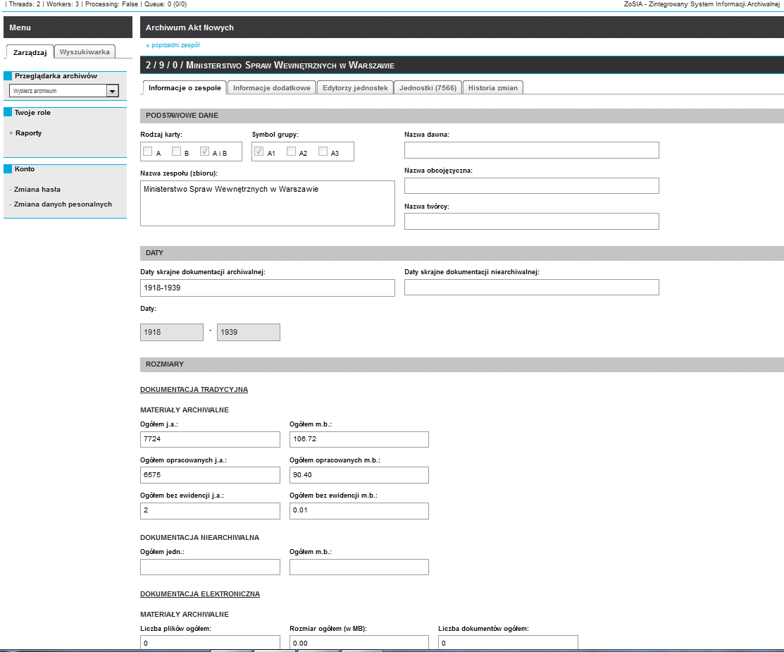
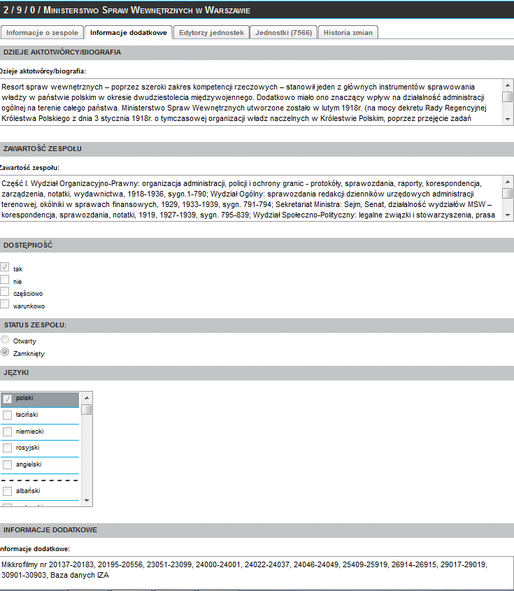
The Integrated Archival Information System “ZoSIA”, fond-level description

Slide 14
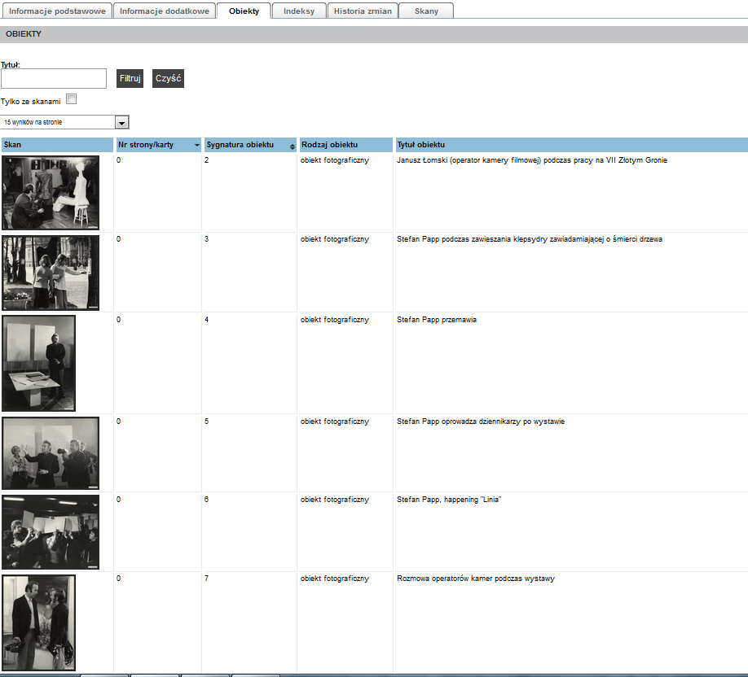
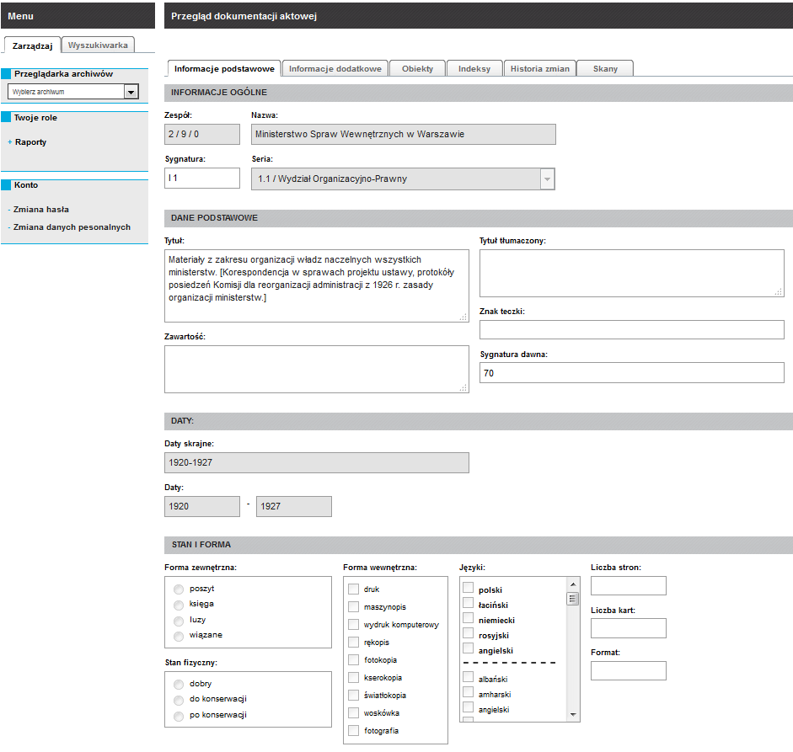
The Integrated Archival Information System “ZoSIA”, unit and object-level description

Slide 15
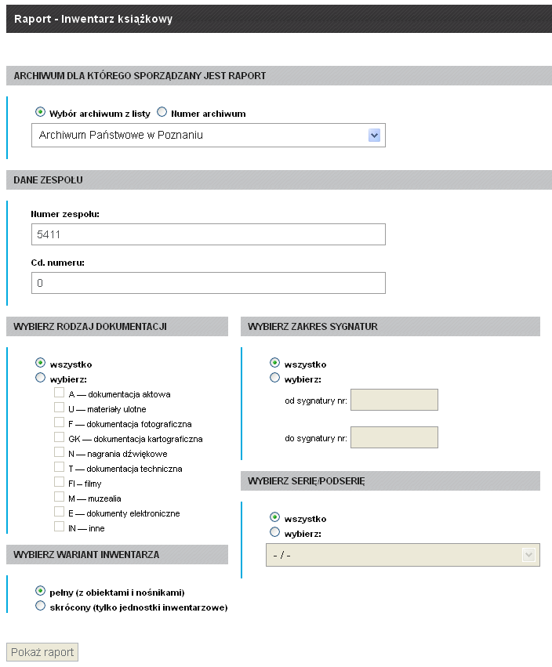
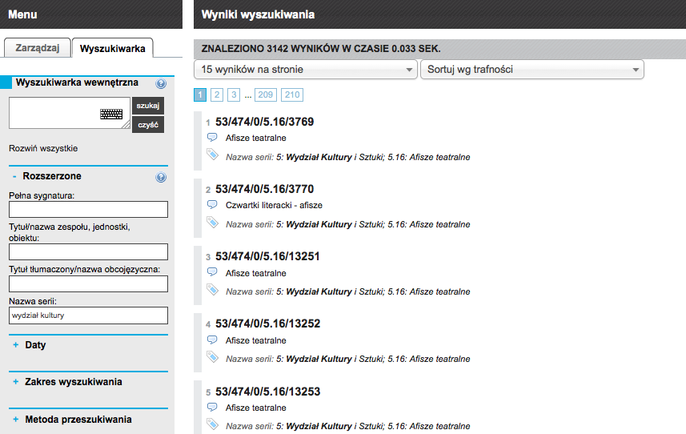
The Integrated Archival Information System “ZoSIA”, search engine and reports

Slide 16
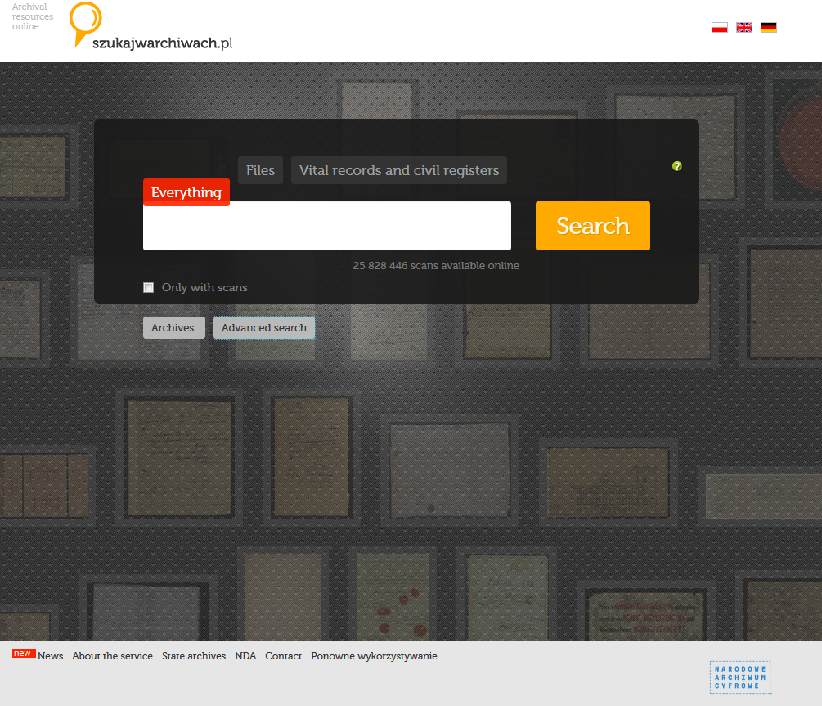
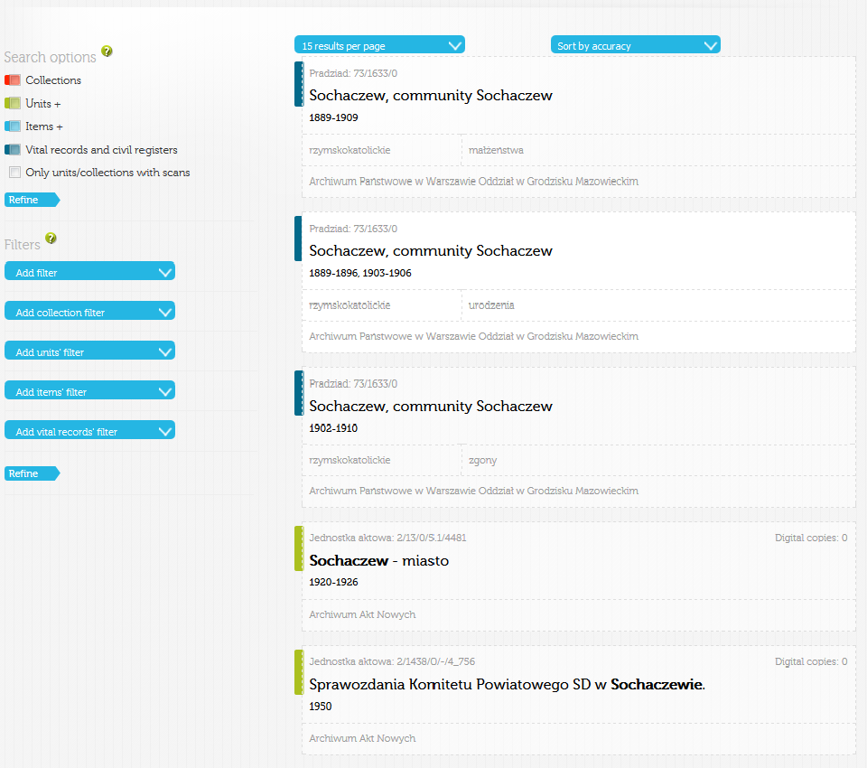
“szukajwarchiwach.pl” portal, online search

Slide 17
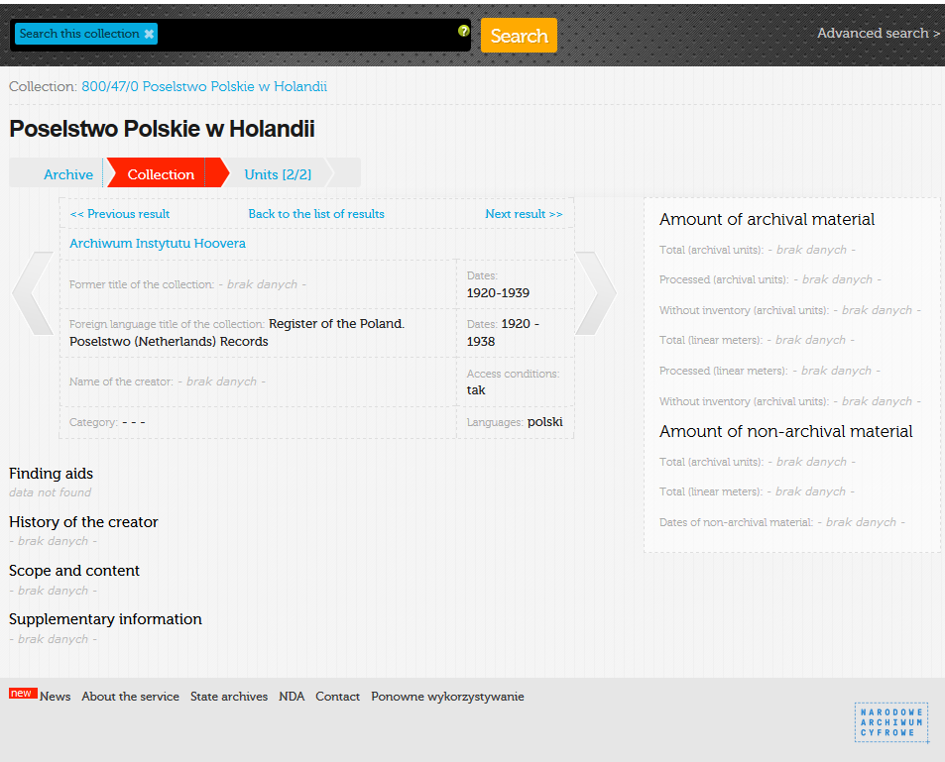
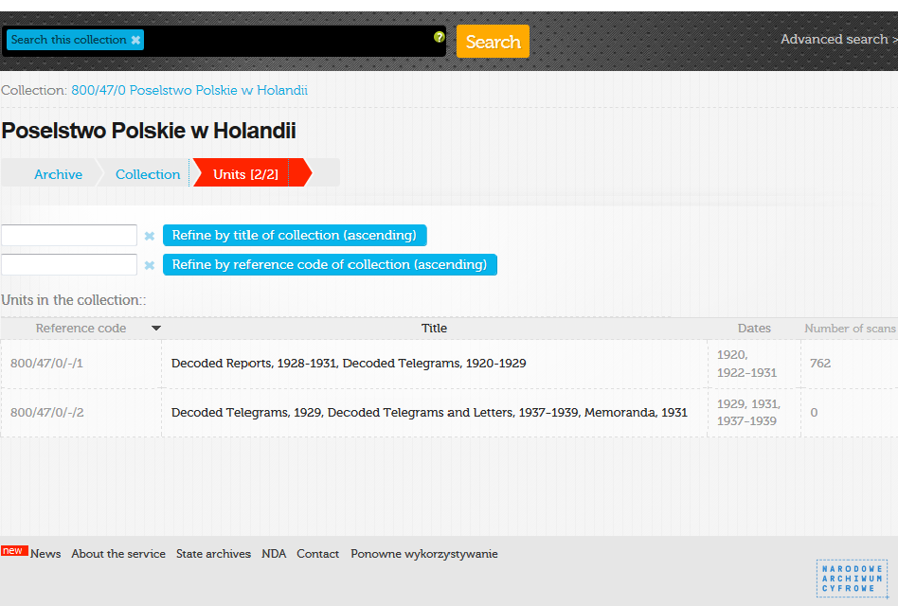
“szukajwarchiwach.pl” portal, fonds-level description

Slide 18
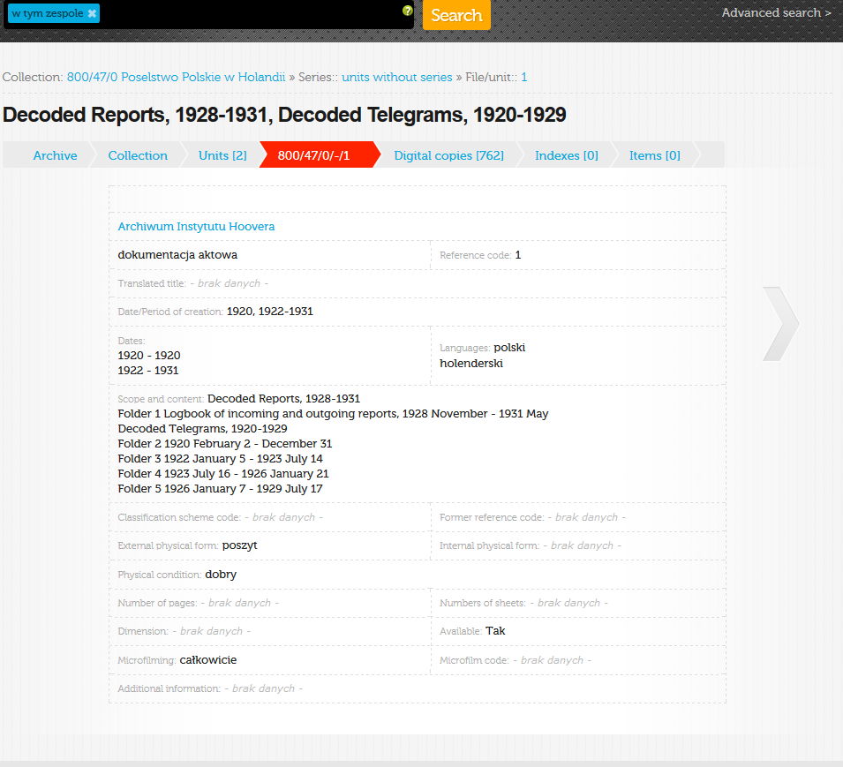
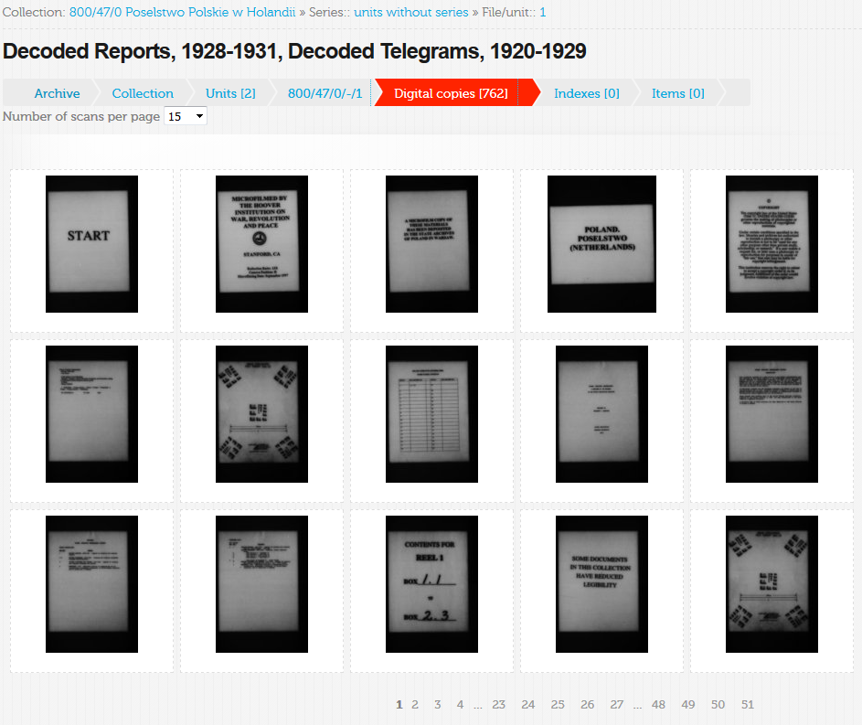
“szukajwarchiwach.pl” portal, unit-level description

