Slide 1
Arkade 5 – The Project
DLM Forum – Oslo – November 15th 2016
any data set
- - Anyone should be able to test anything - - anywhere
By Erik Aaberg, Department of «Archive and IT Development»
The National Archives of Norway, eriaab@arkivverket.no

Slide 2
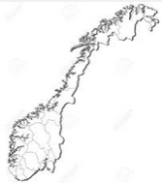
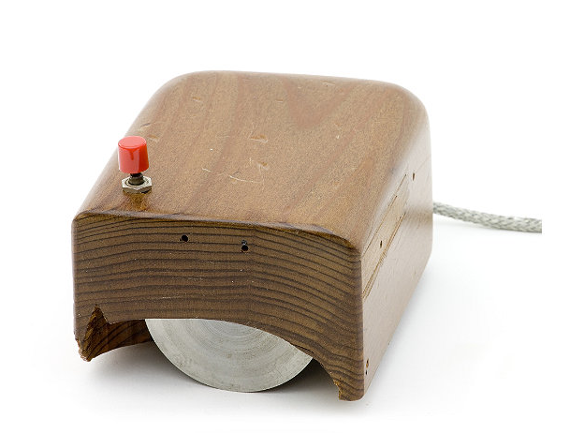
Norwegian Digital Achievements – Hardware
Douglas Engelbart
The First (Computer) Mouse - 1962
Made from real “Norwegian Wood”

Slide 3
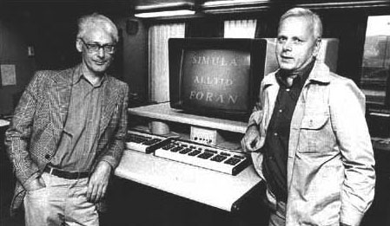
Norwegian Digital Achievements – Software
Ole Johan Dahl and Kristen Nygaard
The First Object Oriented Language – 1962-67
Without whom - - - - Java etc.

Slide 4
Norwegian Digital Achievements – Standards
The First (?) Format Standard for Archives - 1984
The reason for me being here - - -

Slide 5
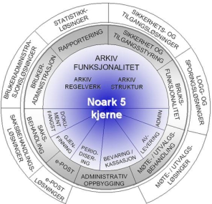
Historic Noark Standards - (and non-standards)
Prequel: 1978 Test of digital extracts - on magnetic tape - one file pr. tape, 1600 bpi
Noark 1 - 1984 - a few data sets received 1985, manual ad hoc verification
Noark 2 - 1987 - simple inspection of files
Noark 3 - 1994 - some more testing, documents still paper-based
Noark 4 - 1999 - "lots of tables" - inspected by software - digital documents
Noark 5 - 2008 - XML based - dedicated software for testing
BUT:
It is estimated - for municipal applications - less than 10% can be formatted to comply with the Noark standard

Slide 6
So - How do we test - now?
Proteus (built on software from SAS Institute) Costly licenses. A bit "out-of-date"
Noark3
Noark4
Arkn4 (Perl based). Can be downloaded. Runs under (certain dialects of) Linux.
Noark5 and specialized systems
Arkade 4 (Java based) But still runs best under Windows
Problems: Bugs, Lack of competence (personnel), Multiple systems "Black boxes", Non intuitive GUI, Not properly maintained

Slide 7
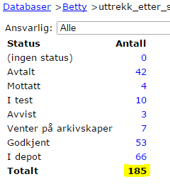
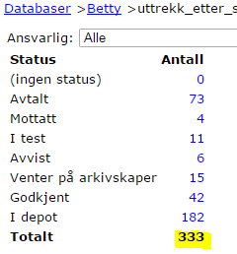
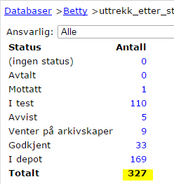
Financial Background : Some statistics
Received by National Archives
300 data sets each year / 1500 within a 5 year period
State institutions
Cost per data set for Nat. Arch. Estimated € 4 000
2013
2014
Estimated future volumes
Now: 6 000 systems
Extracts every 5 years
Calculated as:
€ 4 000 x 6 000 = € 24 million
(€ 4.8 million each year)
2015
Estimated volumes,
municipalities and counties:
5-10 times more - i.e. 6 - 12 000/year
Notes:
Mottak og gjennomstrømming av digitale arkiver
Ligger nå på om lag 300 pr. år
Vi har regnet ut at Riksarkivets utgifter til test av ett system, ligger på ca. 40 tusen
Beregninger som ble gjort i forbindelse med eArkiv-rapporten i 2014
viser at det er ca. 6000 systemer i statlig sektor som er underlagt arkivlovens krav om deponering
Tallene og det dertil hørende Regnestykket tilsier at vi må 4 doble kapasiteten vår, hvis vi skal fortsette å jobbe som i dag
Alternativet er å gjøre ting på en annen måte…
Svaret gir seg selv – vi må etablere helt nye metoder og arbeidsformer
… og ikke minst – finne og fjerne flaskehalsene
Dette er det andre som har funnet ut av – og da kommer det gjerne pålegg fra de som styrer oss….

Slide 8
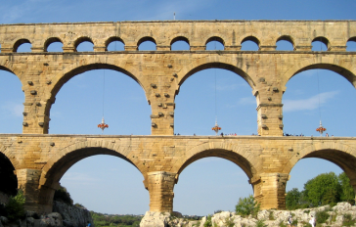
So - What we need
We want archive owners/producers to test before sending an extract (SIP) to the archival institutions
We want one application to be able to test any data set (Noark 3, 4, 5 and specialized systems)
This will reduce cost, time consumption, and increase quality
Ideally, the tasks for the archival institution would be
to confirm data quality, completeness, accuracy and compliance
to store and secure data
to make data available on request
Notes:
For å legge til rette for dette … → neste bilde

Slide 9
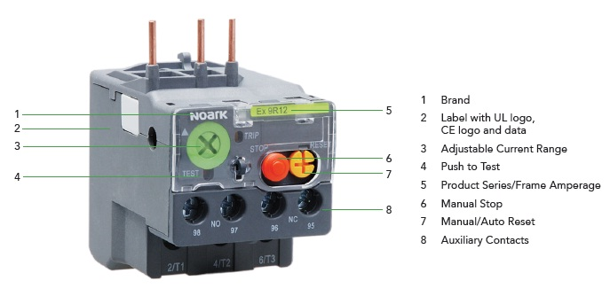
A search for "Noark test" on the web did not provide any ideal solution - -

Slide 10
- - so we had to make our own system
Specifications (many partners involved) - Q2 2015 - Q1 2016
Tenders published (Norway and EU) - April 2016
Development Q3 2016 - Q1 2017, Release March/April 2017
Stakeholder(s) A: Archive producers and owners
Stakeholder(s) B: Archival institutions
Stakeholder(s) C: Software companies and consultants
N.B.: We need close cooperation with all partners Extensive rollout is essential!
Notes:
For å legge til rette for dette … → neste bilde

Slide 11
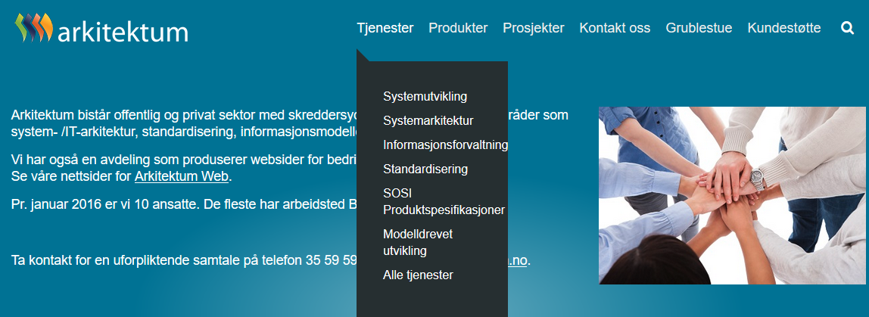
Arkade 5 – Contract was given to:
Arkitektum AS (http://www.arkitektum.no)
A medium-sized company (13 employees) with substantial knowledge of:
Noark and other archival standards
Public requirements
IT architecture and modelling
Methods for agile development
And with very good references
Notes:
For å legge til rette for dette … → neste bilde

Slide 12
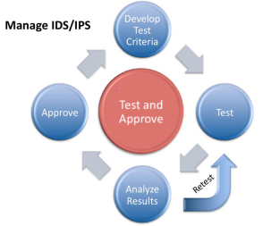
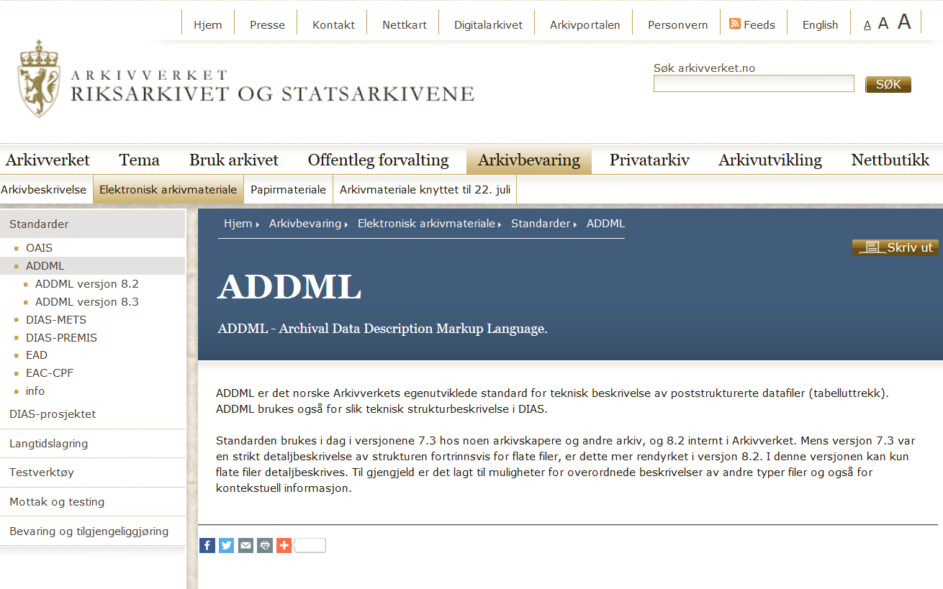
- - but what are the test criteria?
Inseparable partners - "ADDML" and Arkade 5

Slide 13
So what is ADDML?
We have the ADDML XSD (Schema) - Flexible, though with some limitations
We have the ADDML XML (in compliance with the XSD)
The addml.xml file describes in detail the expected content, formats, and dependencies
Flexible definitions of data, but precise descriptions when defined
Most, if not all, relevant archival formats can be described in ADDML

Slide 14
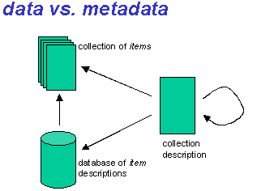
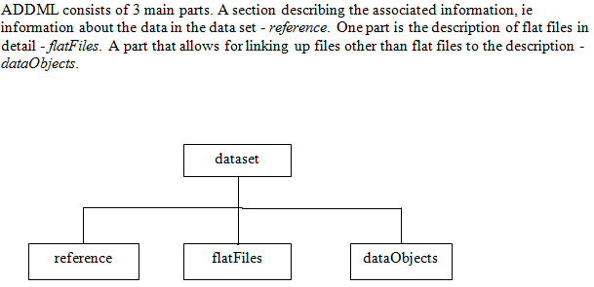
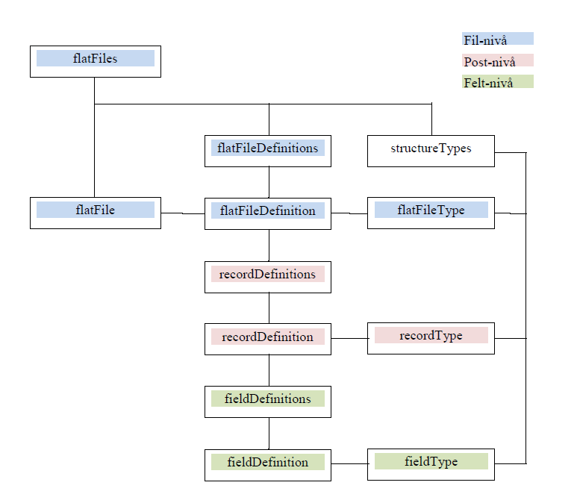
ADDML - An overview
ADDML/ARKADE validations:
Files and references
Fields, formats etc.
Relations - foreign keys
Upper/lower bounds
Processes - Analysis
Processes - Validation
ADDML/ARKADE validations:
Files and their references
XML being well formed - and valid
More to come in 2017: "Components"

Slide 15
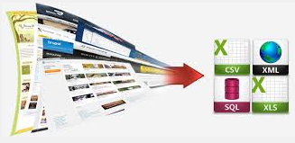
ADDML and our various data extracts
Noark 3: A generic ADDML definition is made
Noark-4: ADDML generated on-the-fly by Arkade 5 (using properties of the N-4 file structure)
Noark 5: "dataObjects" - 100% XML/"dataObject" based - so - in addition to ADDML "standard" - we have built in some extra testing
Specialized systems: ADDML must be produced - one per system
Notes:
For å legge til rette for dette … → neste bilde

Slide 16
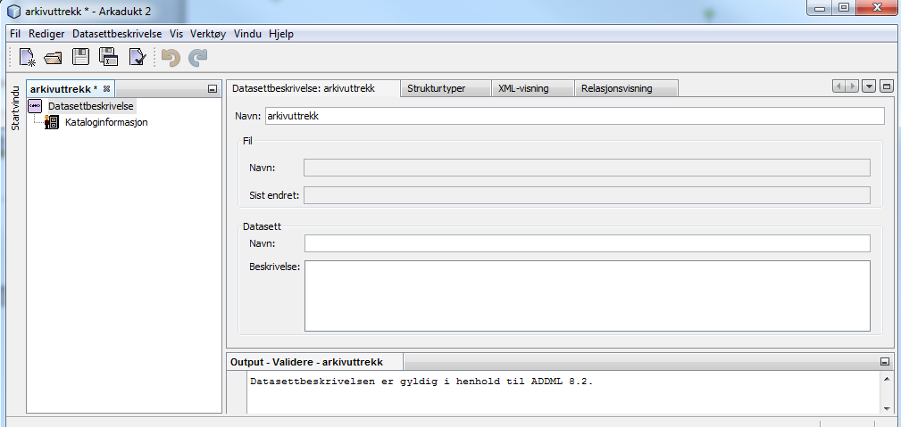
Arkadukt - our software for production of ADDML files (to be upgraded in 2017)

Slide 17
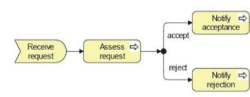
Flow Chart – ADDML and Data Sets
Archivist
Archival Institutions
Record Management (DB)
Field and data-definitions (manual)
ADDML
Schema
Automatic (Arkadukt)
Field and Data definitions ”ADDML XML”
Extracts:
CSV and/or
Fixed Length and/or XML-files
Compliance test (Arkade 5)
Safe Storage

Slide 18
Core elements for the software
100% generic testing - based solely on data and the ADDML
Must read, test, log, present reports - and produce packages
Module based, API provided, SOA architecture
GUI (Interface)
API (Programmers Interface)
Services and Functions
Hooks
External Services
Everything based on open software and published on GitHub
Notes:
For å legge til rette for dette … → neste bilde

Slide 19
A note on language
Installation and support documentation: In English
Comments in the code: In English
User interface: Norwegian ("bokmål") in version 1 But: All dialogue, words, phrases, help texts etc. based on
templates (resource files), making porting to other languages easy

Slide 20
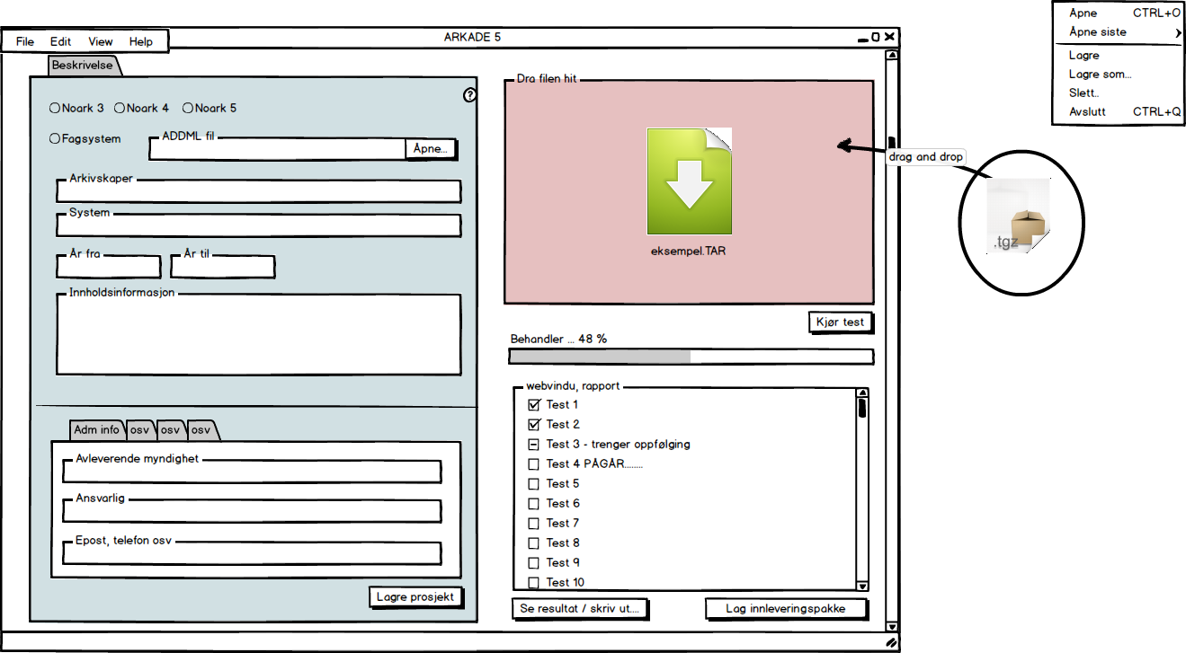
Mockup, Arkade 5 (it's so last year - - -)
-TEST
DOCU MENT ATION
-REPORTS
-MAKE SIP/AIP
Notes:
Arkivleders verktøy
Dokumentere arkivmaterialet
Teste arkivpakken
Opprette en innleveringspakke
Målsettingen er å gi dere et verktøy dere behersker – fremmedgjøringen vil gå ned
Det er viktig å nevne at dette så langt er et forprosjekt –
Vi vet ikke hvilke kostnader prosjektet medfører
- og hvem som skal finansiere et slikt verktøy
- I forprosjektet tar vi kun mål av oss å peke på løsninger som avhjelper den sjakkmatt vi vil komme i i nær framtid

Slide 21
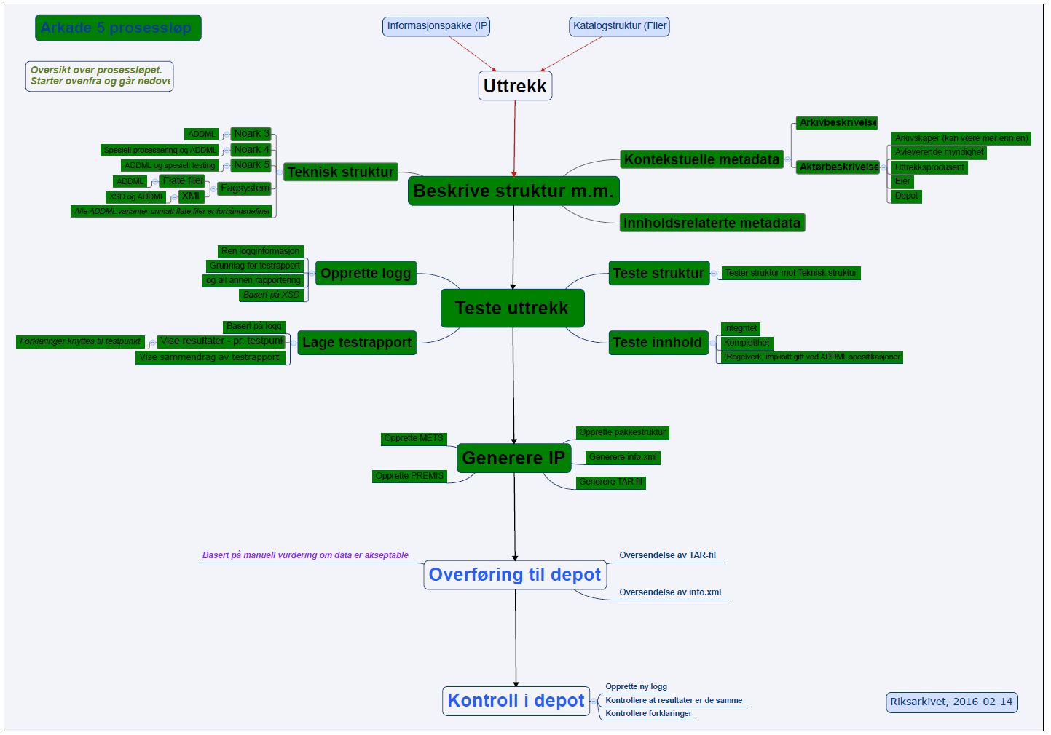
Task Flow (2016) (sorry about the language)

Slide 22
Arkade 5, packages produced (SIPs/AIPs) and the Standards
AIP (<UUID>.tar)
dias-mets.xml (and dias-mets.xsd)
descriptive_metadata/
ead.xml
eac-cpf.xml
administrative_metadata/
dias-premis.xml
arkivuttrekk.xml / addml.xml
repository_operations/
Test reports etc.
AIPs only
content/
Document files and other Contents

Slide 23
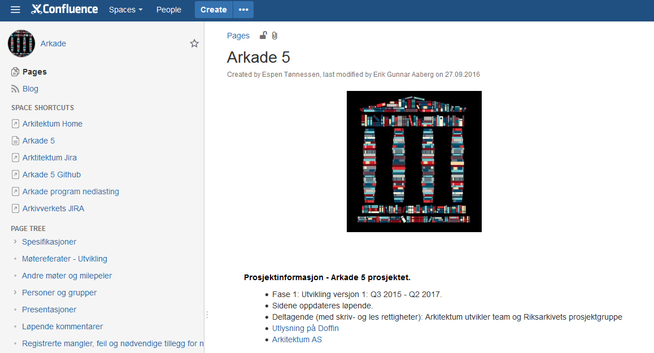
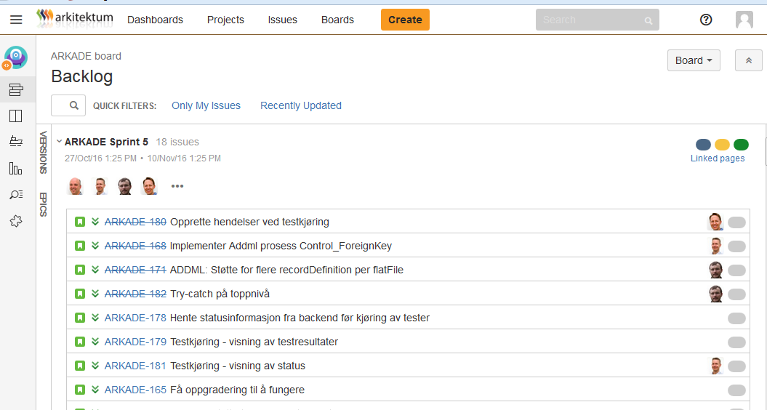
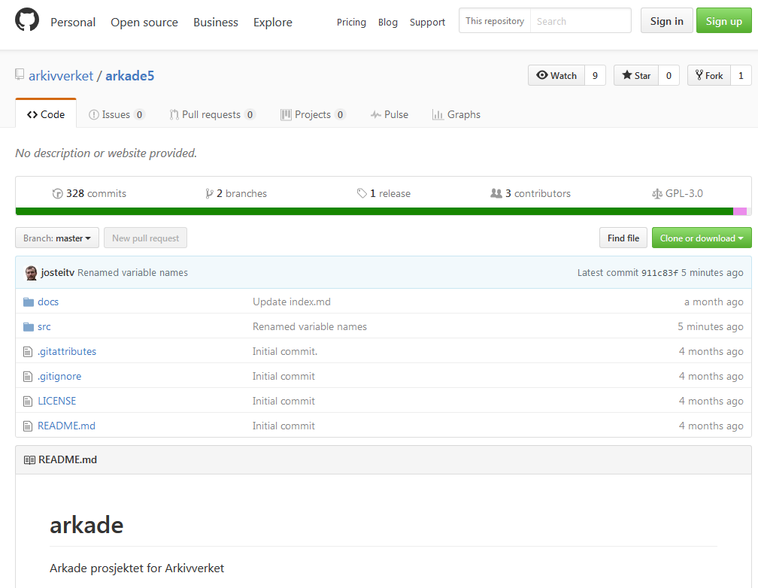
Our preferred tools in the process
Documentation; Confluence
Resource planning, bug tracking: JIRA
Distribution: GitHub

Slide 24
Appendix - Document validations not included Planned as future external services (and our tools are:)
oXygen, validate, check, edit
XML
pdfaPilot (from Callas Software), check (client or server)
PDF (/A)
TIF(F), JPG
So far: Visual test only (standard Windows image software)
Sound/Video
Win Media Player – or VLC - later Mediaconch
Maps
SOSItest (proprietarory Norwegian format and sw)

Slide 25
Arkade 5 – Conclusion
DLM Forum – Oslo – November 15th 2016
- - Anyone will be able to test anywhere
any data set
With the adaption of the ADDML standard - this is also applicable internationally
Any comments and feedback appreciated: Erik Aaberg. eriaab@arkivverket.no

